Slide 1
POST TOF REPAIR
Dr.PRASANTH S

Slide 2
TOF- post repair.
Pathophysiology of repaired TOF.
Post repair survival.
Early outcome determinants.
Long term outcome determinants and evaluation.
Impact of pulmonary regurgitation and requirement of PVR.
Arrhythmias and sudden death.

Slide 3
Pathophysiology of repaired TOF

Slide 4
Pulmonary Regurgitation After TOF Repair
Relief of RVOT obstruction in TOF often involves disruption of pulmonary valve integrity, which leads to PR in the majority patients.
Inevitable consequence of TAP and/or pulmonary valvotomy.

Slide 5
Determinants of the degree of pulmonary regurgitation
(1) Regurgitation orifice area (ROA)
(2) RV compliance
(3) Diastolic pressure difference between the main pulmonary artery (MPA) and the RV
(4) Capacitance of the pulmonary arteries
(5) Duration of diastole
(6) Pulmonary vascular resistance
(7) LV function

Slide 6
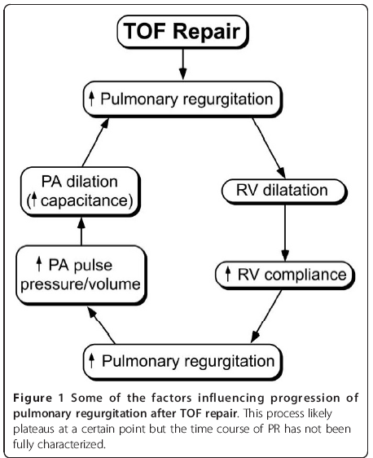
Pulmonary regurgitation
Immediate postop TOF: despite a relatively large ROA, hypertrophic RV and low RV compliance, PA are hypoplatic or their diameters low-normal(low capacitance of PA), relatively high HR (relative short duration of diastole) => minimized the impact of PR.

Slide 7
RV mechanics after TOF repair
Myocardium: a relatively thin compact layer + a prominent layer of trabeculations.
The orientation of the myofibers in the RV -more horizontal and contraction is predominantly from base-to-apex (longitudinal) with a lower degree of angular motion (twist).
Supplied by a single coronary artery with ~50% of the flow occurring during diastole as oppose to ~90% in the LV.
Conduction system in the RV comprises a single fascicle with a long course and a long delay in activation between the base and the distal infundibular free wall, resulting in peristalsis like motion
Although RV function impacts LV function, the reverse is much more pronounced with 63% of RV pressure rise accounted for by LV contraction.
Geva Journal of Cardiovascular Magnetic Resonance 2011, 13:9

Slide 8
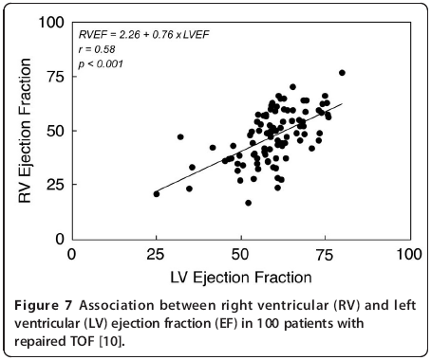
RV-LV Interaction After TOF Repair
The alterations in the size and function of the RV lead to LV dysfunction, a phenomenon termed ‘reversed Bernheim effect’.
They share myofibers, septum, coronary blood flow and pericardial space.
Abnormal coronary artery, prolonged periods of deep cyanosis, LV volume overload after palliative shunts – causes LV hypoxic/ischemic damage.
3 independent predictors of LVEF 24 yrs post repair : (Davlouros et al)
  1.RVEF
  2.Duration of palliative prerepair
  3.Aortic regurgitation

Slide 9
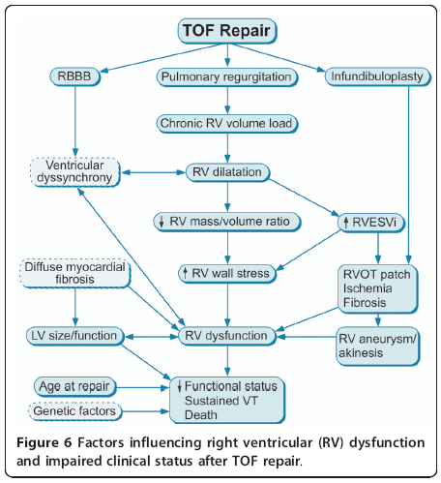

Slide 10
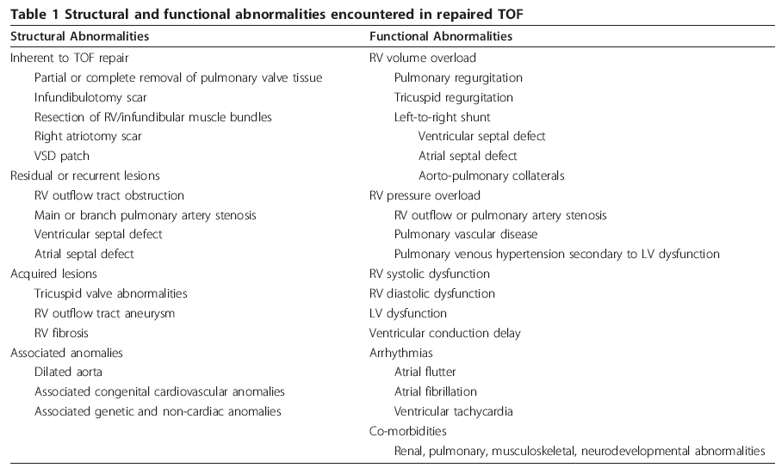

Slide 11
Survival after TOF repair

Slide 12
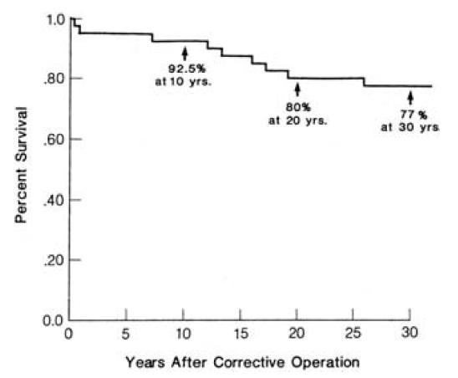
Post TOF survival
Actuarial survival of 105 patients after repair of TOF
Annals of Surgery. 204(4):490, October 1986

Slide 13
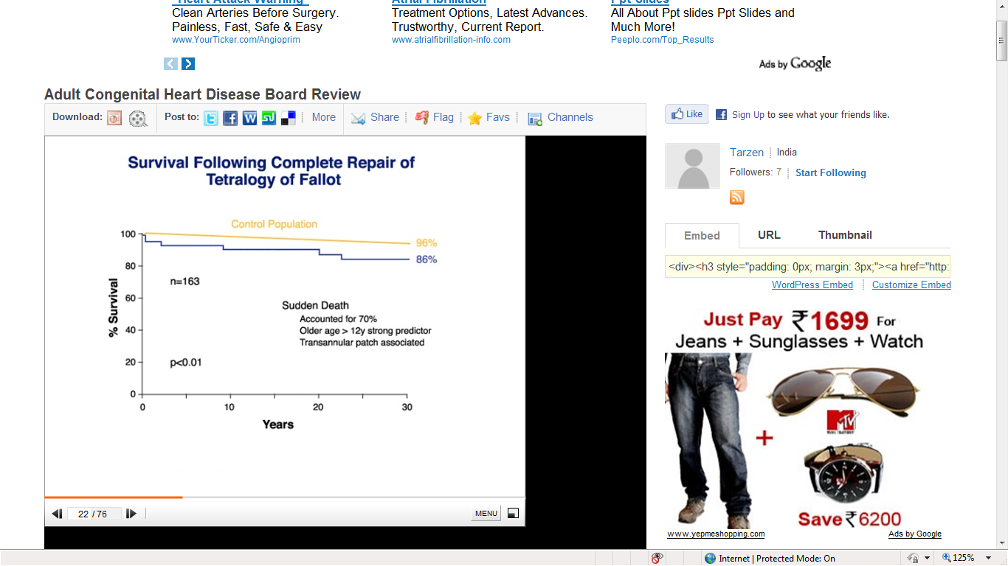
Murphy JG et al. Long-term outcome in patients undergoing surgical repair of tetralogy of Fallot. N Engl J Med 1993

Slide 14
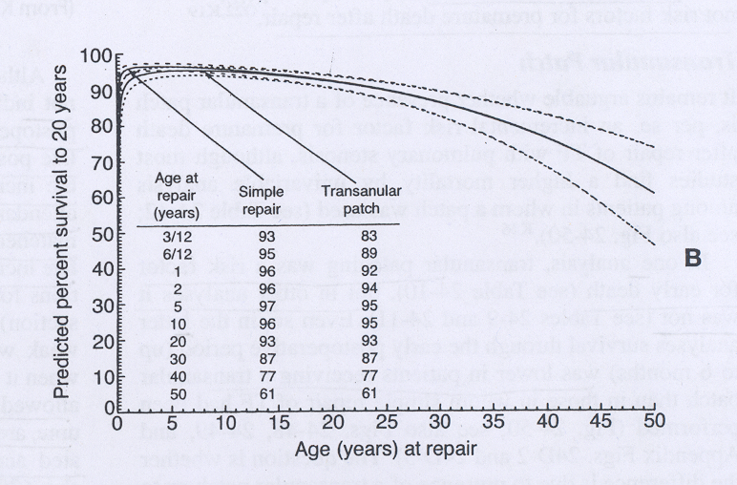
Post surgery outcome – Age and procedure (TAP) related outcome

Slide 15
Early outcome of TOF Repair

Slide 16
Early outcome of TOF Repair ( pre op. factors)
ICR- Early mortality – Risk factors
  Depends on era of Sx .
  Age – unfavorable < 3 months and > 20 yrs
  Associated Lesions- Pulmonary atresia, abnormal PA anatomy, multiple VSD, abnormal coronaries
  Prior AP shunts (due to PAH and PA distortion)
  Hypoplastic RVOT and PA.
  High hematocrit (reflecting prolonged hypoxia)

Slide 17
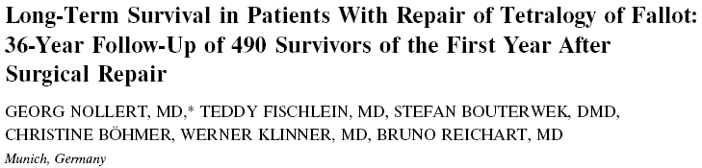
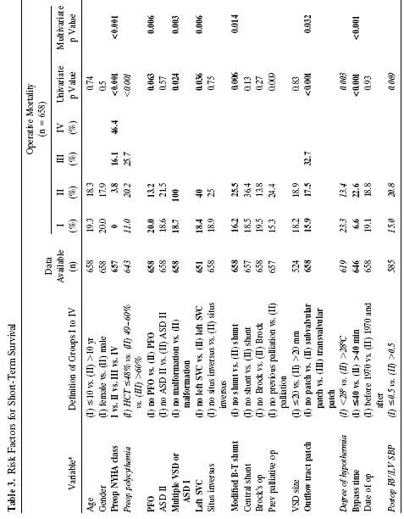
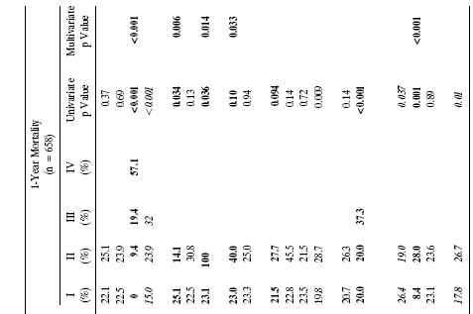
JACC Vol. 30, No. 5
November 1, 1997:1374–83

Slide 18
Residual or unrecognized additional VSD
  Even small 3-4 mm residual VSDs -poorly tolerated because of ass. PR, non compliant RV and unprepared LV for volume overload.
  Results in high filling pressures.
  PA saturation (>80%)
Residual RVOT Obstruction
  Inadequate relief of subpulmonary obstruction or an obstructed or restrictive pulmonary vascular bed (small PAs).
  Well tolerated immediate post op
  Present with murmur and raised RV pressure
  In long term is associated with RV dysfunction, arrhythmia and need for re operation.

Slide 19
Ventricular dysfunction- restrictive physiology
Low cardiac output (C.O.)
  RV systolic dysfunction due to post op stunning (esp. if ventriculotomy is done).
  severe PR.
Manifests as elevated CVP, Hepatomegaly, edema and pleural effusions. Usually recovers in 3- 5 DAYS.
Treatment-
  Drugs- diuretics, digoxin, ionotropes and ionodilators.
  Extended Ventilation

Slide 20
RV diastolic dysfunction
Antegrade late diastolic flow in the PA → atrial contraction is transmitted to the PA → the stiff RV acts as a passive conduit with little or no true RV filling during the late diastole.
Low cardiac output syndrome
Related to the degree of myocardial damage during repair
Inversely related to age at operation
Independent of type of outflow tract repair.

Slide 21
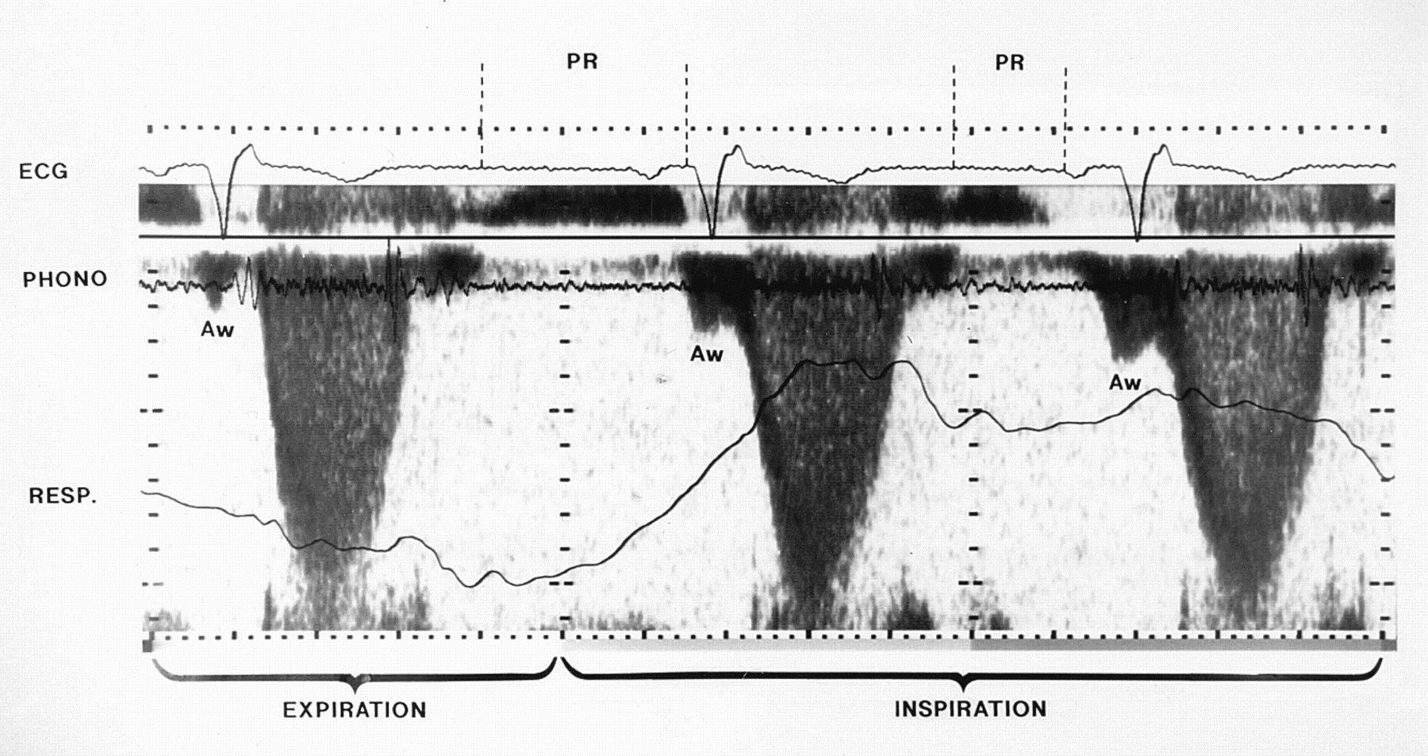
Doppler examination of pulmonary arterial flow in a patient with restrictive right ventricular physiology.

Slide 22
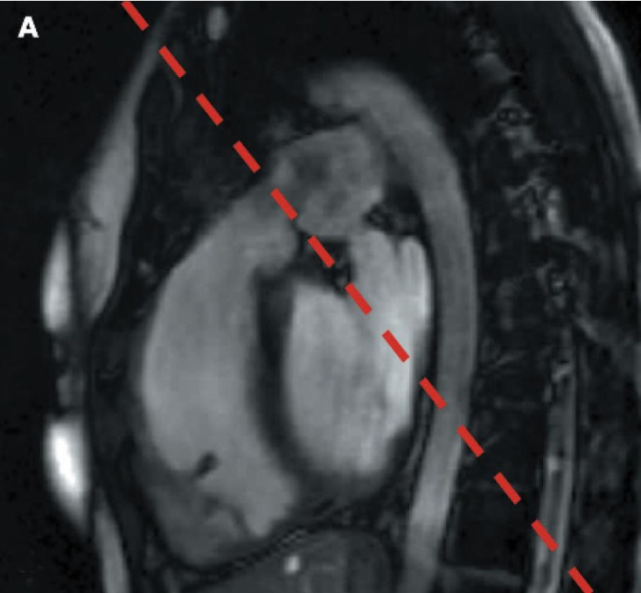
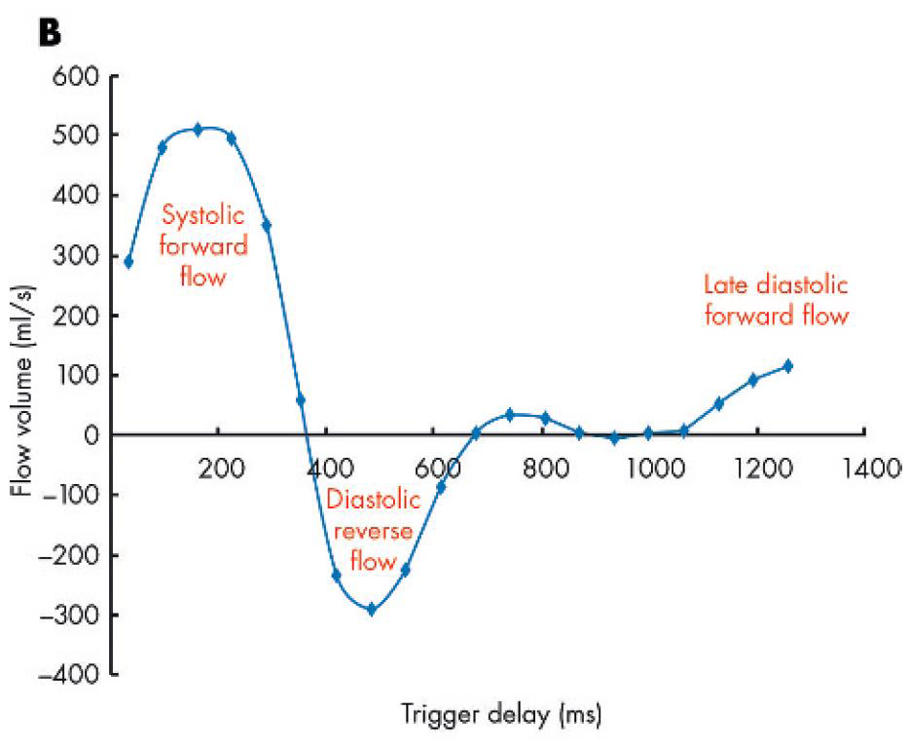
ECG-GATED CINE PHASE CONTRAST MR restrictive RV physiology

Slide 23
Electrophysiological abnormalities
Brady arrhythmias
  Complete heart block (CHB)
    Usually transient, requires pacing if hemodynamically unstable.
  Bifascicular block- 8-12%
  RBBB- almost all cases of ventriculotomy
Tachy arrhythmias
  JET- AV dissociation with JR of 200-300/min.
    If hemodynamically unstable, requires treatment (Amiodarone, overdrive pacing, cooling,correct acidosis,electrolytes)
  Rarely VT

Slide 24
Complete heart block
The incidence of surgically acquired CHB occurred in 10% in pts operated between 1954-55. (Lillehei et al)
Incidence came down to 0.6-1.3% according to recent trials.
Knowledge about the course of conduction tissue and its relationship to VSD is crucial in reducing this complication.
Transient CHB persisting beyond 3rd POD- strongly correlated with sudden death.
Hokanson JS, Moller JH. Significance of early transient complete heart block as a predictor of sudden death late after operative correction of tetralogy of Fallot. Am J Cardiol 2001

Slide 25
Late Outcomes after TOF repair

Slide 26
Late Outcomes after TOF repair
Residual
RVOT obstruction at several levels
VSD: Swiss cheese/ multiple
RV diastolic dysfunction
Sequelae
RV/LV dysfunction
Pulmonary regurgitation
Tricuspid regurgitation
Arrhythmias
    Atrial: Atrial Fl/F
    Ventricular: VT

Slide 27
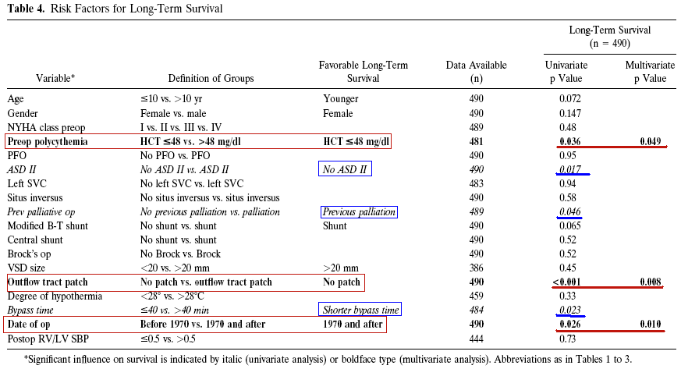
JACC Vol. 30, No. 5
November 1, 1997:1374–83

Slide 28
Echocardiography in adults with TOF
Assessment of physiologic and hemodynamic parameters that influence outcome
  1.RV and LV size and function
  2.Pulmonary regurgitation and / or stenosis
  3.Tricuspid regurgitation
Assessment of anatomic criteria of unknown significance on outcomes : RVOT aneurysm, aortic dilatation and aortic regurgitation

Slide 29
Role of CMR
Quantitative assessment of LV and RV volumes, mass, SV and EF.
Evaluation of regional wall motion abnormalities.
Imaging the anatomy of the RVOT, pulmonary arteries, aorta and aorto-pulmonary collaterals.
Quantification of PR, tricuspid regurgitation, cardiac output and pulmonary-to-systemic flow ratio.
Assessment of myocardial viability with particular attention to scar tissue in the ventricular myocardium.

Slide 30
Pulmonary regurgitation
Shinebourne and Anderson(Paediatric Cardiology, 2002)-60% to 90% of repaired Fallot pts have some degree of pulmonary regurgitation.
Worse late outcome-
  Late age of repair
  had undergone a large right ventriculotomy, excision of extensive muscular trabeculae and a large TAP.

Slide 31
Pulmonary regurgitation
Significant PR -
  Right ventricular dilatation
  Impair right ventricular performance
  Tricuspid regurgitation
  Predispose to atrial flutter/fibrillation, ventricular arrhythmias and sudden cardiac death.
Restrictive RV diastolic physiology –
  delay/inhibit progressive right ventricular dilatation and dysfunction
  by reducing the amount of pulmonary regurgitation.

Slide 32
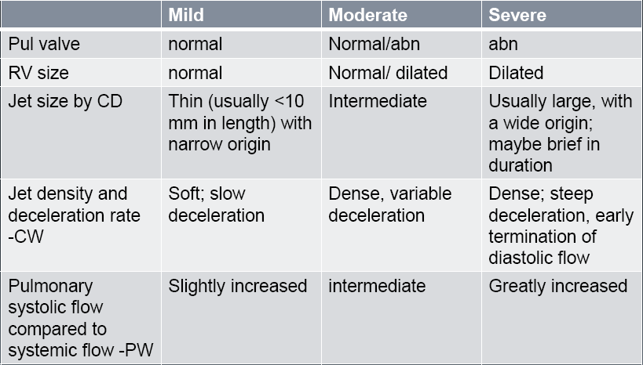
Evaluation of PR: PR grade by 2D Echo
J Am Soc Echocardiogr 2003;16:777-802

Slide 33
Echocardiographic Assessment of PR.
The ratio of jet width / RV outflow diameter (measured at valve level):
  mild ≤1/3
  moderate 1/3 -2/3
  severe ≥ 2/3
Ratio of duration of PR/ duration of diastole < 0.77 correlates with PR regurgitant fraction > 24.5% by CMR
Pressure half time <100 ms correlates with hemodynamically significant PR
Presence of diastolic flow reversal in branch pulmonary arteries is associated with hemodynamically significant PR

Slide 34
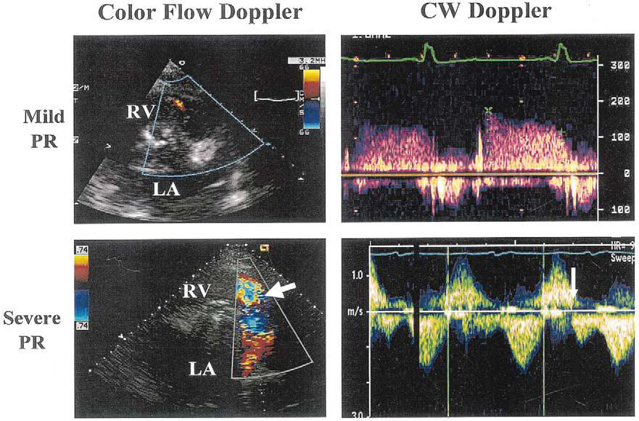
Color flow and CW Doppler

Slide 35
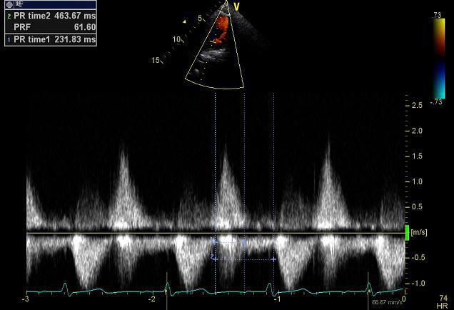
PR severity (CW Doppler)
PR duration: from the onset in early diastole to the end of the PR Doppler signal
Total diastolic time: measured from the end of forward pul flow (coinciding with the onset of the retrograde PR flow) to the beginning of the next forward pulmonary flow curve
The ratio btw duration of PR and total diastolic time = PR index (Pri)
  Mild : through diastole
  Moderate: late diastole
  Severe: mid-diastole or earlier
<0.77 : significant PR
Am Heart J 2004;147:165–172

Slide 36
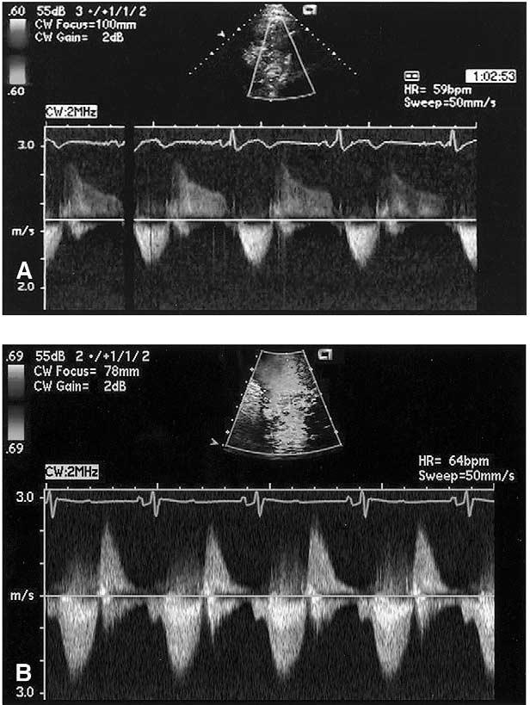
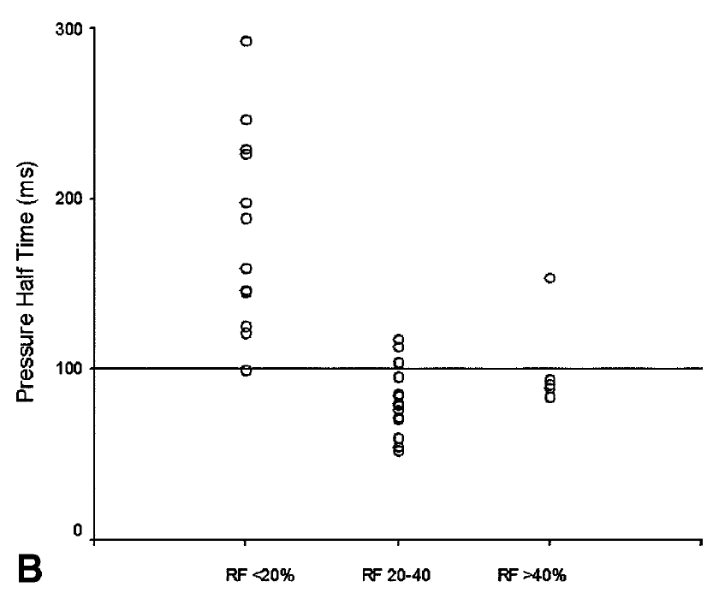
Pressure half-time / PR
J Am Soc Echocardiogr 2003;16:1057–1062
PHT < 100 ms :significant PR

Slide 37
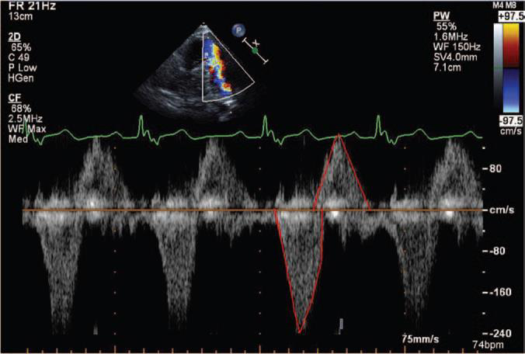
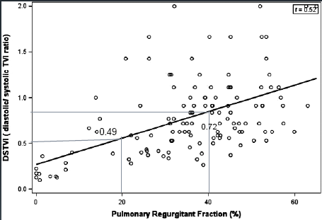
Quantifying Pulmonary Regurgitation in repaired TOF
PW in MPA
The ratio of diastolic / systolic time velocity integral (DSTVI)- >0.72 =RF>40%
Circ Cardiovasc Imaging 2012;5;637-643

Slide 38
CMR-Quantification of PR: two distinct method
Phase contrast (PC) analysis of flow through the MPA & retrograde flow
  Indexed PR volume (mL/m2) and PR fraction.
Ventricular stroke volume (SV) differential measurements derived from steady-state free-precession(SSFP)cine imaging
  Indexed PR volume (RVSV –LVSV) (mL/m2)
  PR fraction (RVSV –LVSV / RVSV x 100 %)
European Heart Journal (2009) 30, 356–361

Slide 39
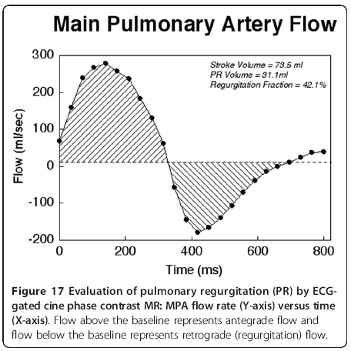
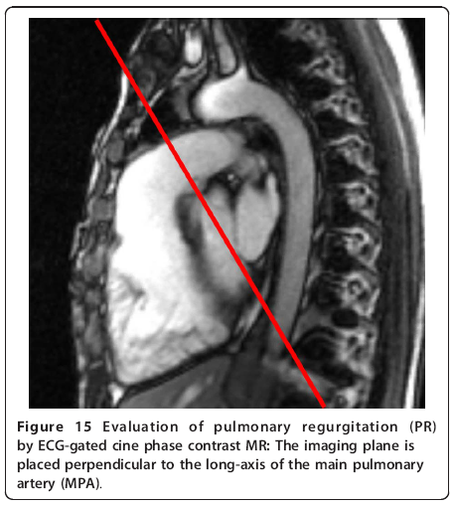
ECG-GATED CINE PHASE CONTRAST MR

Slide 40
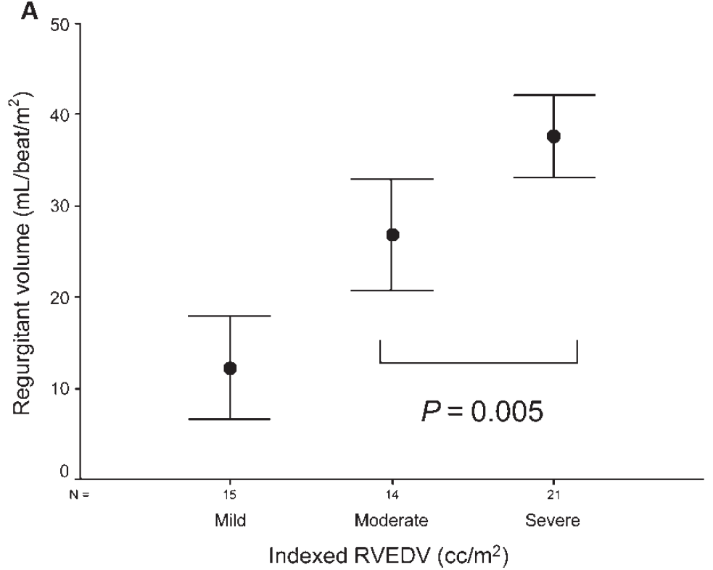
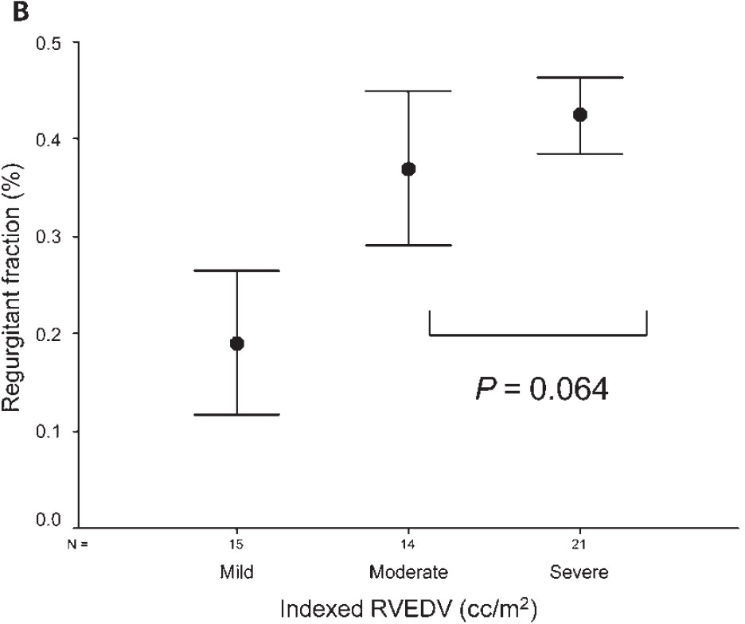
MRI-PR assessment European Heart Journal (2009) 30, 356–361
PR volume and PR fraction are not interchangable.
PR volume may be a more accurate reflection of RV preload and may better represent physiologically significant PR as compared with PR fraction.

Slide 41
Timing and indications of PVR
Most of the symptomatic c/c severe PR pts referred for PVR- have markedly dilated RV with RV/LV dysfunction.
Most of the pts with RV EDV<150ml/m2, RV ESV <82 ml/m2, RVEF>48%- RV size returned to normal 1 yr post PVR.
The timing and indications for PVR- must balance the benefits of elimination of RV volume load before irreversible dysfunction occurs and the disadvantages of a premature surgical or transcatheter procedure.

Slide 42
Indications for Pulmonary Valve Replacement
Moderate or severe pulmonary regurgitation (regurgitation fraction ≥25%)
Asymptomatic patient with two or more of the following criteria
  RV end-diastolic volume index >150 ml/m2 or Z-score >4. (In patients whose body surface area falls outside published normal data: RV/LV EDV ratio >2 )
  RV ESV index >80 ml/m2
  RV EF <47%
  LV EF <55%
  Large RVOT aneurysm
  QRS duration >140 ms
  Sustained tachyarrhythmia related to right heart volume load
  Other hemodynamically significant abnormalities: RVOTO, severe branch PS, moderate TR, residual L->R shunt (Qp/Qs ≥1.5),severe AR, Severe aortic dilatation (diameter ≥5 cm)

Slide 43
Indications for Pulmonary Valve Replacement
Symptomatic patients:
  Symptoms and signs attributable to severe RV volume load documented by CMR or alternative imaging modality, fulfilling ≥1 of the quantitative criteria detailed above.
Exercise intolerance not explained by extra-cardiac causes with documentation by exercise testing (≤70% predicted peak VO2 for age and gender).
Signs and symptoms of heart failure.
Syncope attributable to arrhythmia.
Geva Journal of Cardiovascular Magnetic Resonance 2011, 13:9

Slide 44
Indications for Pulmonary Valve Replacement
Special considerations:
a. Due to higher risk of adverse clinical outcomes in patients who underwent TOF repair at age ≥3 years , PVR may be considered if fulfill ≥1 of the quantitative criteria.
b. Women with severe PR and RV dilatation and/or dysfunction may be at risk for pregnancy-related complications.
Geva Journal of Cardiovascular Magnetic Resonance 2011, 13:9

Slide 45
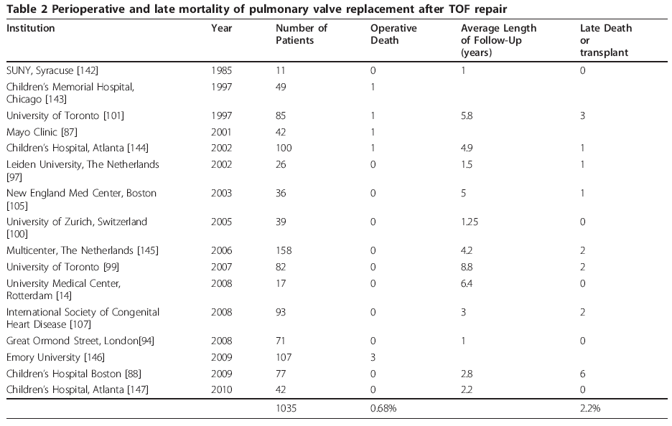
PVR after TOF repair

Slide 46
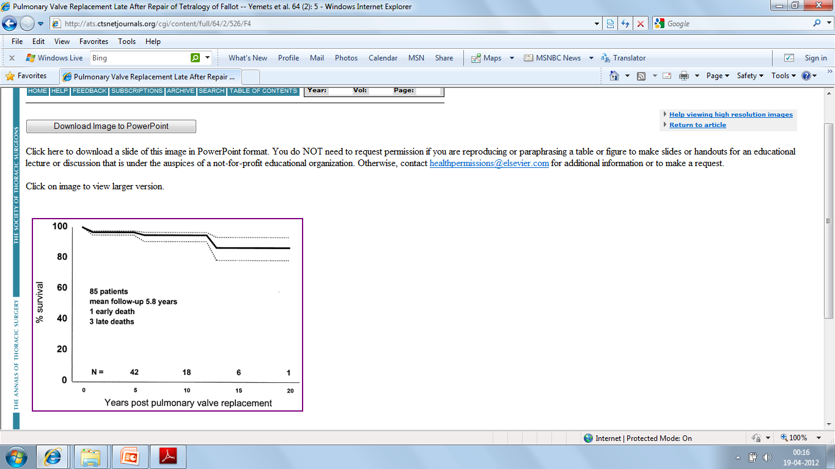
Survival after Pulmonary valve replacement
The actuarial survival: 95% ± 3% at 10 years
87% ± 8% at 15 yrs
Yemets et al; Ann Thoracic Surg 1997; 64:526-530

Slide 47
Benefits of PVR
Highly effective in eliminating or significantly reducing PR.
Significant improvement in NYHA functional class.
RV EDV and ESV reduce by 30-40% as compared with preop values.
Degree of TR tends to improve.
Therrien et al reported incidence of VT lower after PVR (9% vs 23%).
Data regarding effects of PVR on QRSd, objective exercise parameters- inconsistent.

Slide 48
Transcatheter PVI
First reported by Bonhoeffer et al, Lancet. 2000;356:1403–1405 -
  Valved segment of bovine jugular vein sewn within a balloon-expandable stent
Melody valve
  A bovine jugular vein valve sutured within a platinum iridium stent.
  One size valve (18 mm) that is crimped to 6 mm and re-expanded from 18 mm to 22 mm.
  Thin, compliant leaflets open fully and close readily with a minimum of pressure.
  Balloon-in-balloon catheter delivery system with a retractable PTFE sheath covering.
  Nylon inner and outer balloons available in three sizes: 18 mm, 20 mm and 22 mm.
  At inflation, the inner balloon is half the diameter of the outer balloon.

Slide 49
Transcatheter PVI
Provide new non-surgical option for the treatment of failed bioprosthetic pulmonary valve.
Currently limited to mostly patients with RV-to-pulmonary artery conduits.(size and geometry of RVOT).
Further development of this technology may reduce the need for reoperation after pulmonary valve implantation.

Slide 50
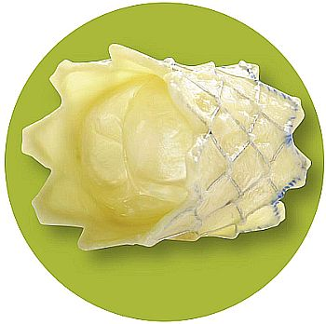
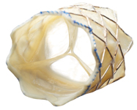
Indications for Transcatheter PV placement
  Severe PR with RV dilation / dysfunction in FC I
  moderate PR + FC II and above
  RVOT gradient > 40 mm Hg for FC I
  RVOT gradient > 35 mm Hg + FC II and above

Slide 51
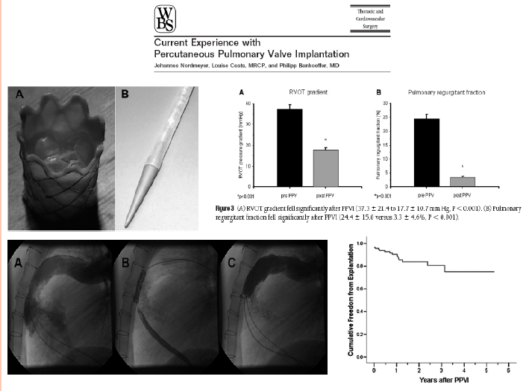

Slide 52
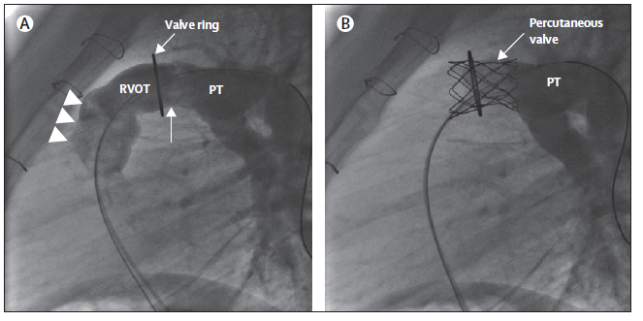
Lateral still-frame PA angiograms showing PT and RVOT before (A) and after (B) PVR
Percutaneous implantation of a stented valve within the previous valved conduit.

Slide 53
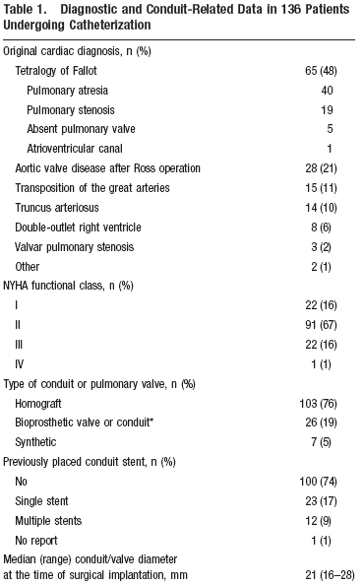
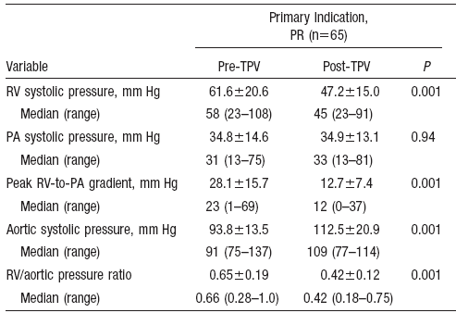
US Melody valve trial

Slide 54
Branch Pulmonary Artery Angioplasty:
Indication
Dilation may be considered when RV pressure is more than 50% of the systemic level or at lower pressure when there is RV dysfunction.
It may also be considered when there is unbalanced pulmonary blood flow (eg: 75% and 25%), or unexplained dyspnea with severe vascular stenosis and evidence of segmental hypo perfusion by radionuclide studies

Slide 55
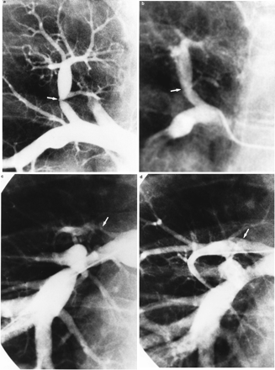
Notes:
Selective pulmonary angiograms before (a and c) and after (b and d) balloon pulmonary angioplasty (BPA). a, Severe stenosis (arrow) of the superior segment of the right lower lobe pulmonary artery; b, injection demonstrating marked improvement in vessel diameter (arrow) after BPA; c, severe stenosis (arrow) of the right upper lobe pulmonary artery with minimal flow distribution to that lobe; and d, angiogram of right pulmonary artery after BPA of right upper lobe showing marked angiographic improvement in vessel diameter (arrow).

Slide 56
Post TOF repair complications :
Sudden Death and Arrhythmias
Risk of sudden death – 0.5% to 6%
Predictors of Sudden death:
  Severe PR
  Younger age at the time of repair
  R V dilatation, outflow tract aneurysms
  History of sustained VT
  QRS duration >180 ms
  Moderate or severe LV dysfunction

Slide 57
Mechanoelectrical interactions
Chronic PR- direct mechanical effects+ electrical deterioration of heart.(both are pathophysiologically linked).
QRSd ≥180 msec- sensitive & specific predictor for later symptomatic VT and/or sudden death.
Rate of QRSd progression(>5 msec/yr over 5 yrs)- predicts sudden cardiac death.
QRSd ≥ 180 ms was 35% sensitive and 97% specific for induced sustained monomorphic ventricular tachycardia.
1.Gatzoulis MA et al; risk factors for arrhythmia and sudden cardiac death late after repair of TOF ,multicentre study;Lancet 2000.
2.Balaji S. QRS prolongation is associated with inducible ventricular tachycardia after repair of tetralogy of Fallot. Am J Cardiol 1997

Slide 58
Nonsustained ventricular arrhythmia on ambulatory electrocardiographic recordings did not predict sudden death. Cullen et al; J Am Coll Cardiol 1994
Vigorous pharmacotherapy of VT not associated with reduced risk of sudden death.
saul et al
Right atrial approach to repair of tetralogy of Fallot significantly reduced the risk of life threatening arrhythmias without increasing the risk of supraventricular arrhythmias
Dietl CA et al. Life-threatening arrhythmias and RV dysfunction after surgical repair of tetralogy of Fallot. Comparison between transventricular and transatrial approaches. Circulation 1994

Slide 59
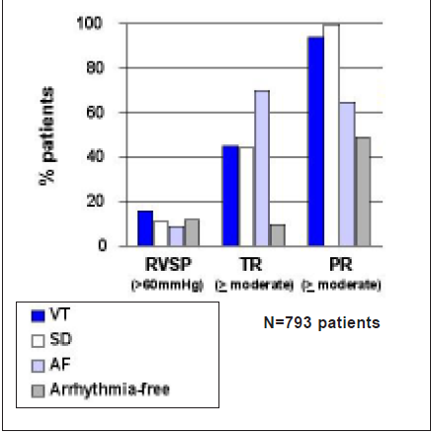
Post TOF repair complications :
Sudden Death and Arrhythmias
Pulmonary Regurgitation:
- main underlying hemodynamic
lesion for patients with sustained
VT and SCD
Hemodynamic substrate in patients with sustained tachyarrhythmia and SCD late after repair of TOF
Gatzoulis et al, Lancet 2000;356:975-981

Slide 60
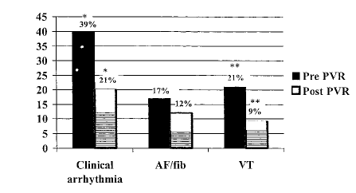
Impact of PVR on Arrhythmia
Propensity Late After Repair of Tetralogy of Fallot
Change in incidence of clinical arrhythmia after PVR.
Dashed area represents de novo arrhythmia after PVR
Circulation. 2001;103:2489-2494.

Slide 61
Aortic root dilatation
Infants with TOF with severe RVOTO are born with dilated ascending aorta( absolute diameter increased as a result of volume overload on developing aorta)
Prevalence of > mild AR- 6.6% of pts 15 yrs post repair.
Aortic dissection- rare complication.
88 children post repair(median age 7 months)- serial aortic root measurements taken. Annulus and sinotubular z scores returned to normal within 7 yrs.
Early repair might prevent aortic dilation.
Francois et al. The fate of aortic root after early repair of TOF. Eur J Cardiothorac Surg 2010.

Slide 62
Atrial flutter and fibrillation
Associated with older age at repair, a higher frequency of hemodynamic abnormalities and increased morbidity.
Among 242 pts with repaired TOF, 29 pts (12%) sustained episodes of serious atrial arrhythmias.
The development of atrial arrhythmias was associated with substantial morbidity including congestive heart failure, reoperation, ventricular tachycardia, stroke and death (combined events, 20 of 29 pts; 69%).
Patients with atrial arrhythmias were older at surgical repair (25 ± 16 vs. 10 ± 9 yrs, P = 0.001) and at most recent assessment were aged 48 ± 12 vs. 32 ± 10 yrs (P = 0.001), as compared with arrhythmia free pts.
Harrison DA et al. Sustained atrial arrhythmias in adults late after repair of tetralogy of Fallot. Am J Cardiol 2001; 87: 584–8.

Slide 63
Infective endocarditis
Well known complication post TOF repair.
Frequency increases after PVR.
Affect aortic valve, tricuspid valve, pulmonary artery, residual VSD, AML in its area contiguous with AV.
Morris et al; 30 yr incidence of endocarditis in repaired TOF 1.3%.
Require life long infective endocarditis prophylaxis.
Importance of maintaining good oral hygeine.

Slide 64
Contraception and pregnancy
Issues reg. genetics, recurrence risk and fetal screening to be discussed.
Caution with OCP in women with significant ventricular dysfunction, atrial arrhythmias b/c associated risk of thromboembolism.
Pregnancy usually well tolerated.
The risks of pregnancy depends on severity of residual lesions, degree of ventricular dysfunction and likelihood of developing arrhythmia.

Slide 65
Procedures for Rerepair of Tetralogy of
Fallot in Adults
Pulmonary valve replacement
Residual subvalvular obstruction or pulmonary artery stenosis
Residual VSD closure
Sx for Aneurysm of RVOT
MAPCAs coiling
Atrial and ventricular arrhythmia- RFA or surgery.
Tricuspid valve repair for significant tricuspid regurgitation
AVR for aortic regurgitation
Closure of residual PFO or ASD, if any.
Replacement of ascending aorta for dilatation(very rare).

Slide 66
MCQs

Slide 67
First TOF repair by an open heart procedure done by
Kirklin and wallace, 1946
Lillehei and Varco,1954
Murphy and Mair, 1956
Parry and McElhinney,1958

Slide 68
According to ACC/AHA 2008 guidelines, echocardiographic assessment should be done in TOF repaired pts at intervals of
6 months
One yr.
Two yrs
Three yrs

Slide 69
All are indications for Pulmonary Valve Replacement in aymptomatic post TOF repair pts, except
RV end-diastolic volume index >150 ml/m2
RV ESV index >80 ml/m2
regurgitation fraction ≥40%
RV EF <47%

Slide 70
Commonest arrhythmia in early post op period
Atrial fibrillation
Junctional ectopic tachycardia.
Ventricular tachycardia
CHB

Slide 71
Commonest cause of mortality in late post TOF repair
VT
CCF
SCD
SVT

Slide 72
Pri- PR index
The ratio of diastolic / systolic time velocity integral
The ratio duration of PR / total diastolic time
Regurgitant jet width / RVOT diameter
None of these

Slide 73
Significant PR by echocardiography indicated by all except
The ratio of jet width / RV outflow diameter ≥ 2/3
PHT >100 ms.
PR index <0.77.
Presence of diastolic flow reversal in branch pulmonary arteries.

Slide 74
All are determinants of degree of PR, except
RV compliance
Diastolic time duration
Degree of Tricuspid regurgitation
Capacitance of the pulmonary arteries
LV function

Slide 75
Which of the following statement is incorrect
Transient CHB beyond 72 hrs postop among TOF repaired pts, strongly correlated with SCD.
NSVT in Holter monitoring predict sudden death in post TOF repair pts.
LV systolic dysfunction and QRSd >180ms predicts sudden death in TOF repaired pts.
Transatrial approach for TOF repair reduces the risk of late life threatening arrhythmias.

Slide 76
THANK YOU

Slide 77
3D Echo in TOF
The mean RV EF were 42 ± 8% on 3D ultrasound and 44 ± 7% on MRI (r = 0.89, P < .0001). The mean EDV were 249 ± 66 and 274 ± 82 mL and the mean ESV 147 ± 50 and 159 ± 60 mL on 3D ultrasound and MRI, respectively.
JASE 2010 Feb;23(2):127-33.
Three-dimensional echocardiography underestimated ESV and EDV (P < 0.001) but agreement between 3DE and MRI was excellent (ICC = 0.88 and 0.87, respectively). Ejection fraction was 47.7 +/- 7.8 with 3DE and 47.9 +/- 6.7 with MRI, agreement between both methods was good (ICC = 0.72).
Eur J Echocardiogr. 2009 Aug;10(6):784-92
However, the accuracy of 3DE echo diminishes with larger RV volumes, in part due to current difficulty to include the entire RV in the imaged sector.

